Slide 1
Final Presentation
Vivian Lin(vivianl5) Cheng Ai(chengai2) Haoyu Liu(haoyul11)

Slide 2
Project Outline
Introduction and Motivation
Data Cleaning Decision
Preliminary Analysis
Model Data Preprocessing
Best Model Discussion
Additional Analysis/Insight
Conclusion

Slide 3
Motivation
Background
Predictive
Personal Experience
Challenge
Machine Learning Model

Slide 4
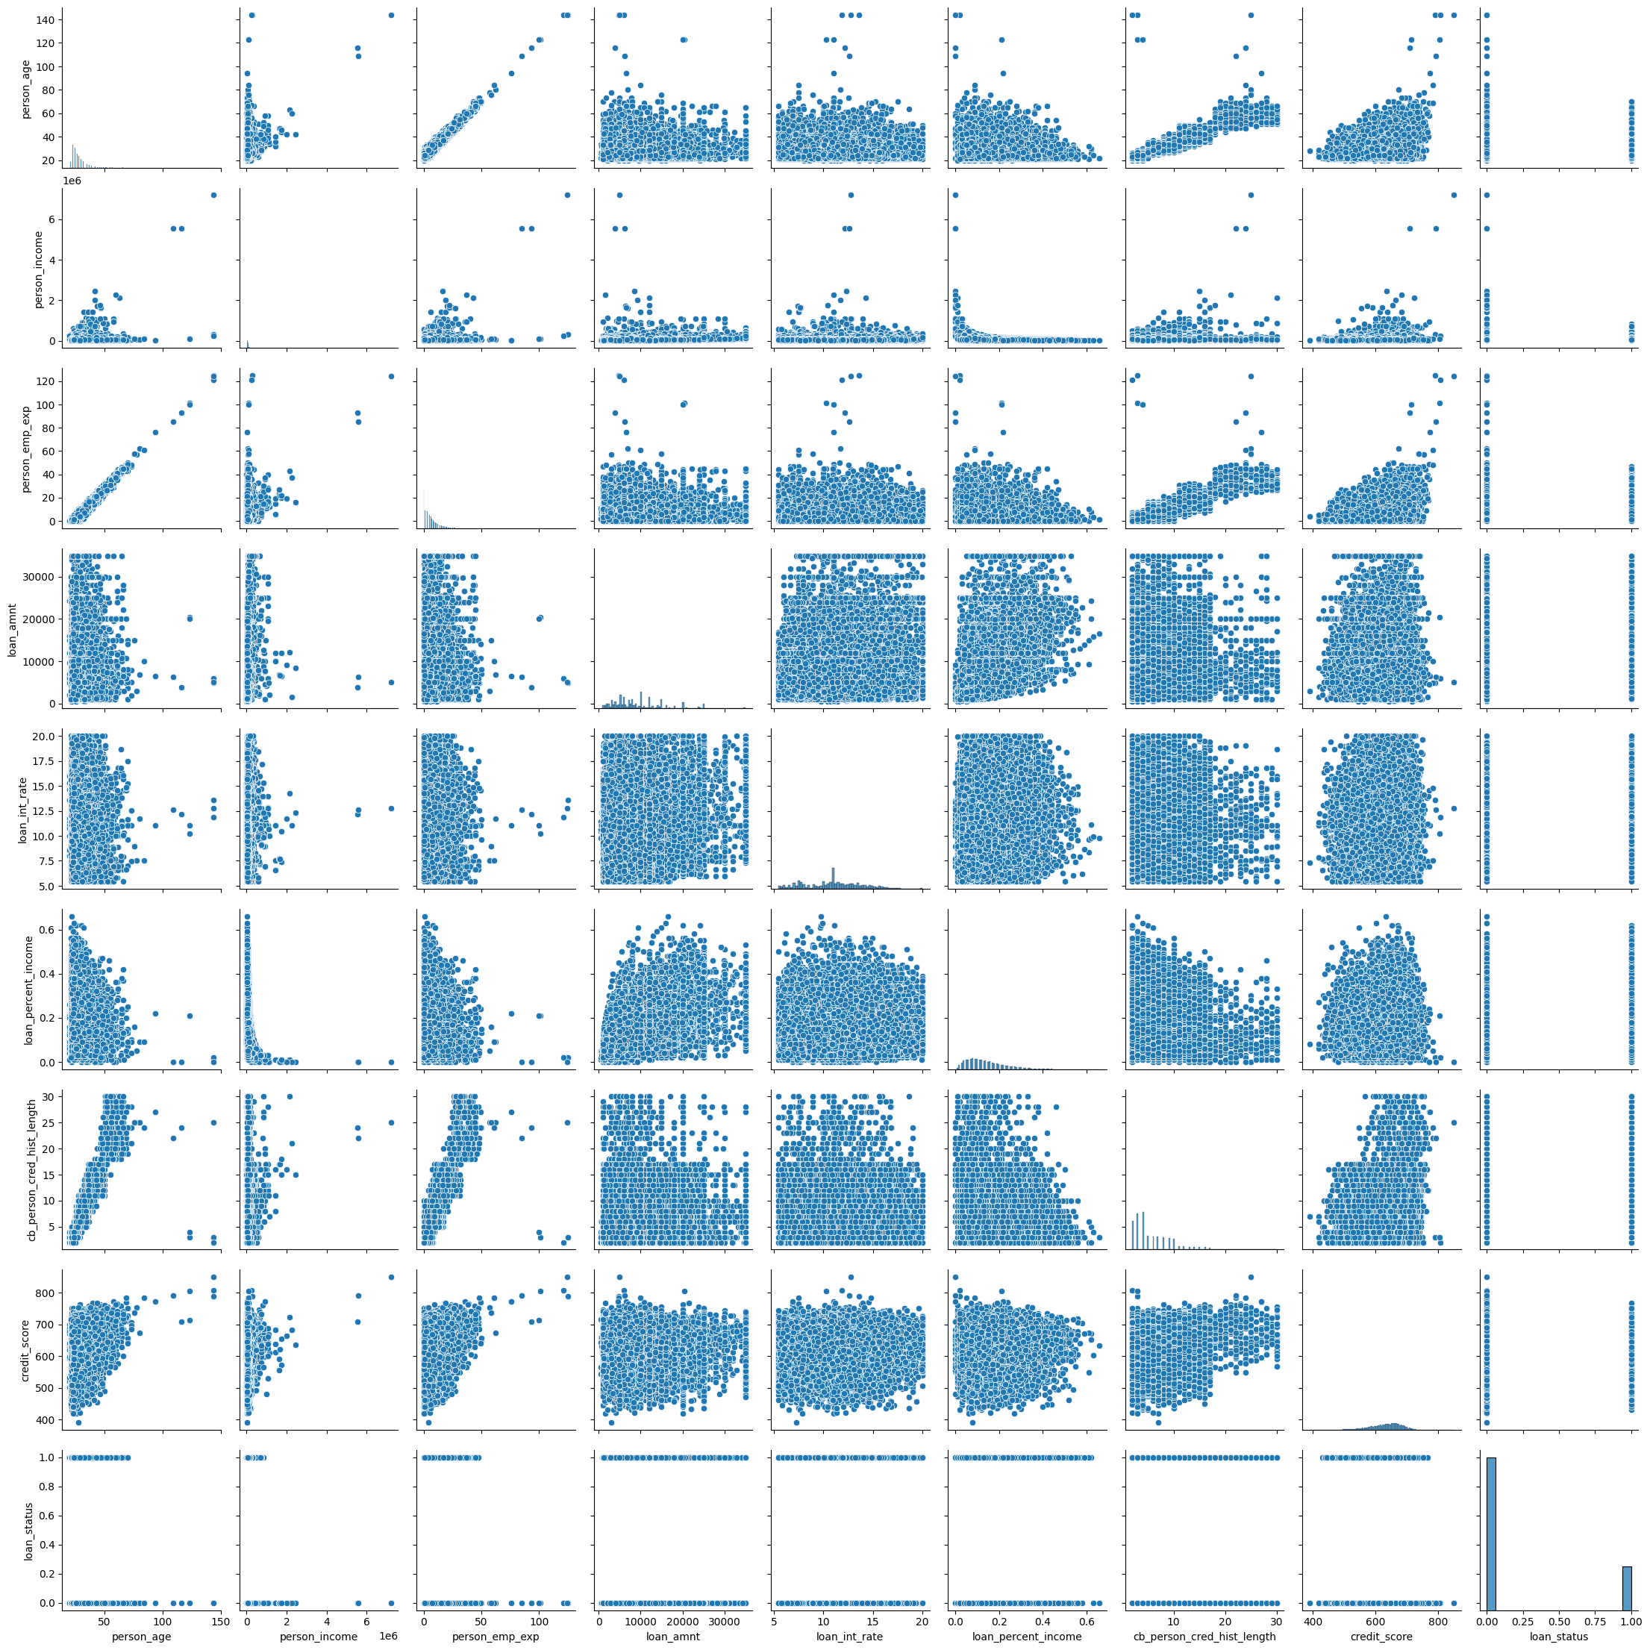
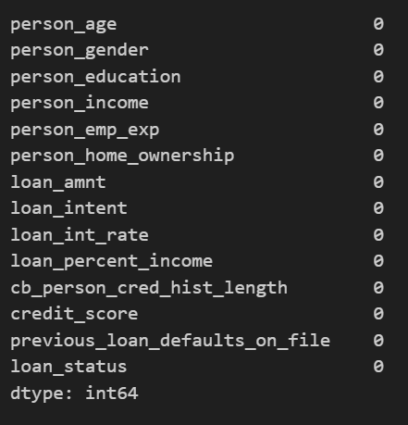
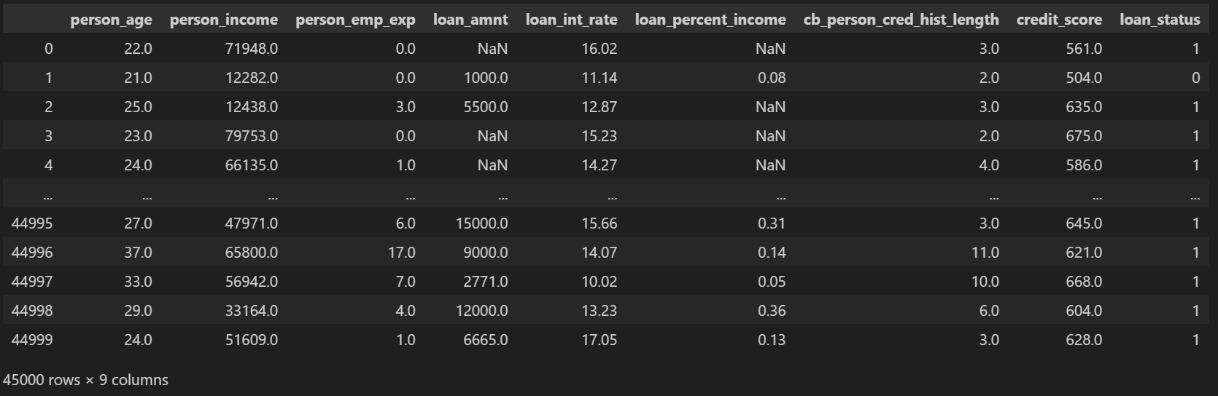
Data cleaning decisions
Check for NaN values
Outliers observation
Other data cleaning: Whole dataset outliers dropping

Slide 5
Preliminary Analysis
Categorical Variable Relationships with Loan Status
Numerical Variable Relationships with Loan Status
Multicollinearlty Asscessment
Finding Interactions between Categorical and Numerical Explanatory Variable Pairs

Slide 6
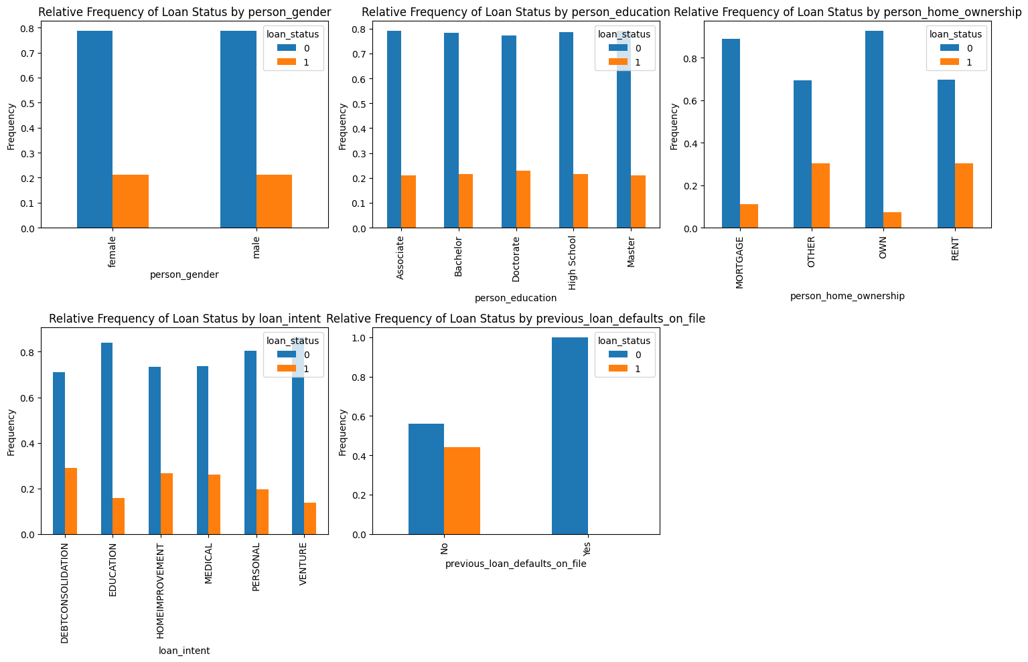
Categorical Variable Relationships with Loan Status

Slide 7
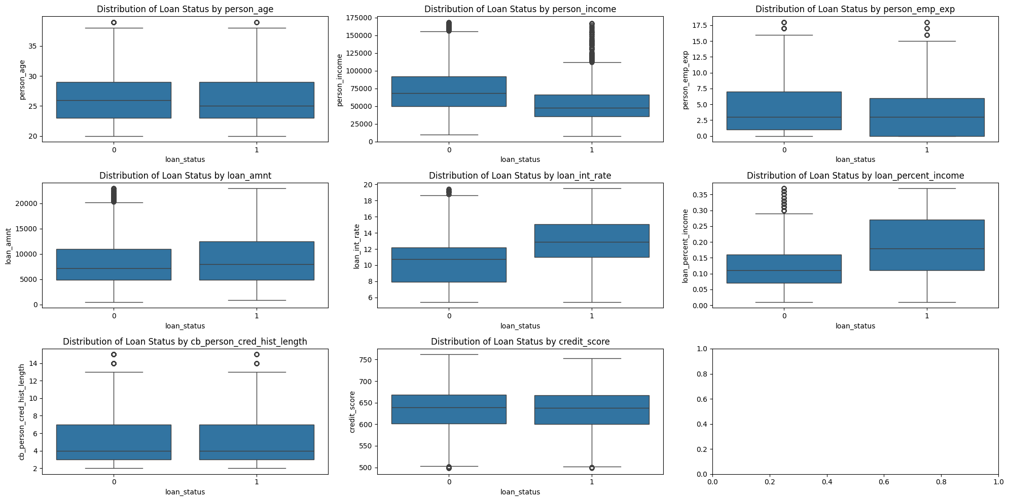
Numerical Variable Relationships with Loan Status

Slide 8
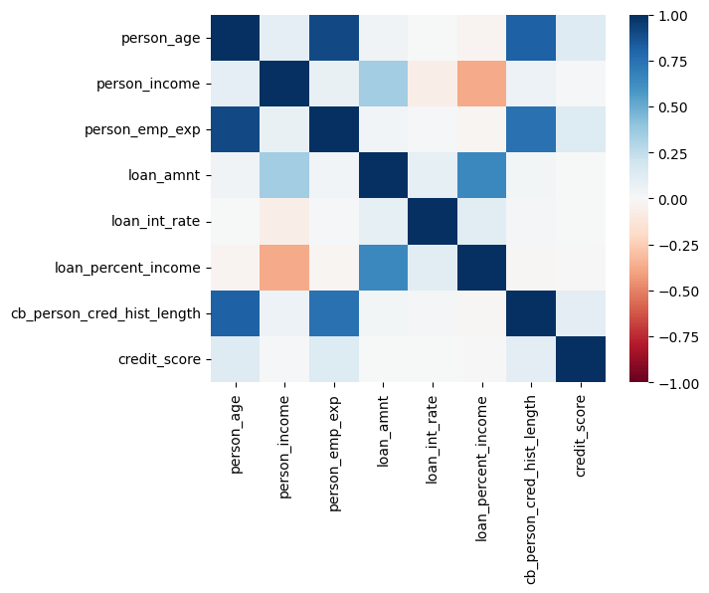
Multicollinearlty Asscessment

Slide 9
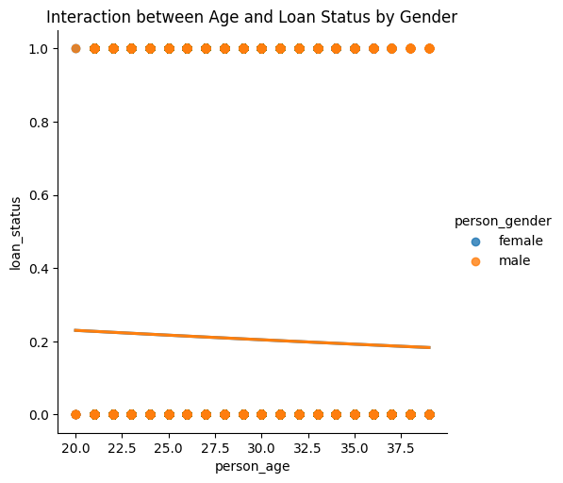
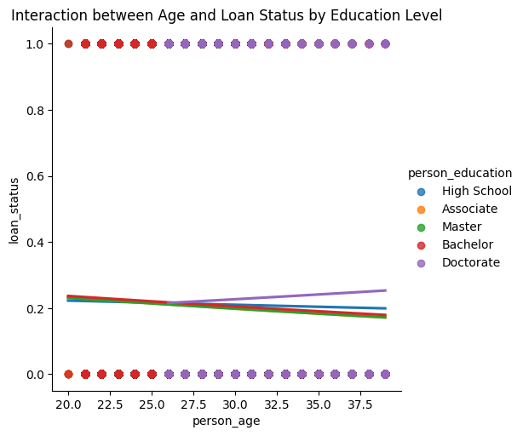
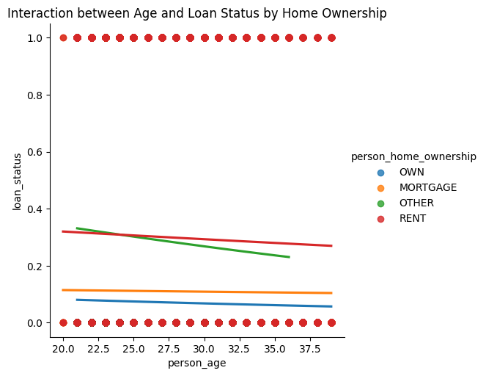
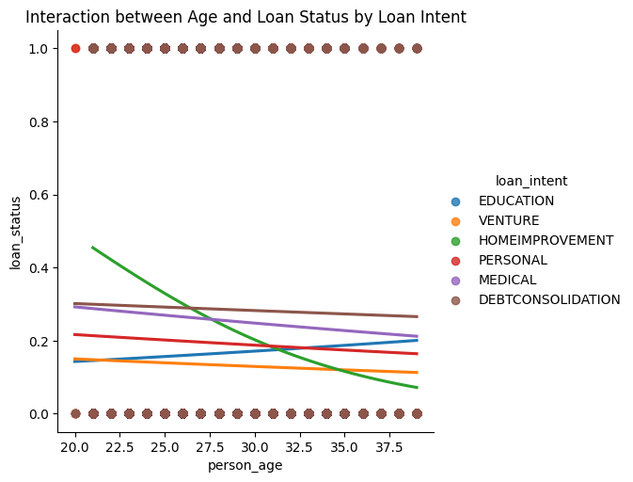
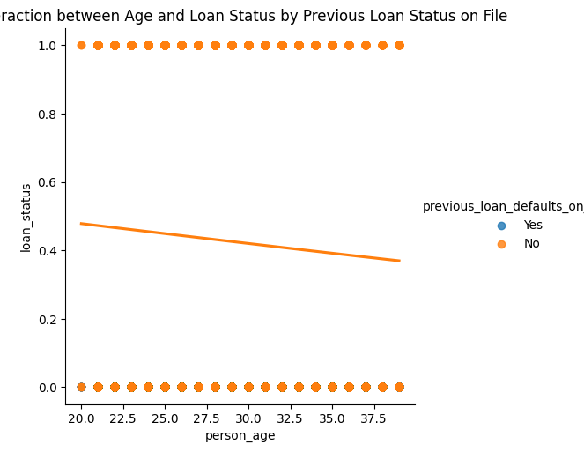
Finding Interactions between Categorical and Numerical Explanatory Variable Pairs

Slide 10
Model Data Preprocessing
Check the form of our response variable
Create the feature matrix and target array
Test code
Scaling
Convert the indicator variable to the correct form
Test code

Slide 11
Best Model Discussion
Best Model Equation
Test Dataset ROC Curve
Multicollinearity Asscessment
Overfitting Asscessment
Best Predictive Probability Threshold

Slide 12
Best Model Equation
Backward elimination
5-fold cross-validation
AUC = 0.9522
Eight key predictors: loan_amnt, loan_int_rate, loan_percent_income, cb_person_cred_hist_length, credit_score, person_home_ownership, loan_intent, previous_loan_defaults_on_file
Interaction terms excluded (to prevent overfitting and test‑set bias)
Data standardized → coefficient size reflects feature importance
previous_loan_defaults_on_file_Yes is the most influential variable

Slide 13
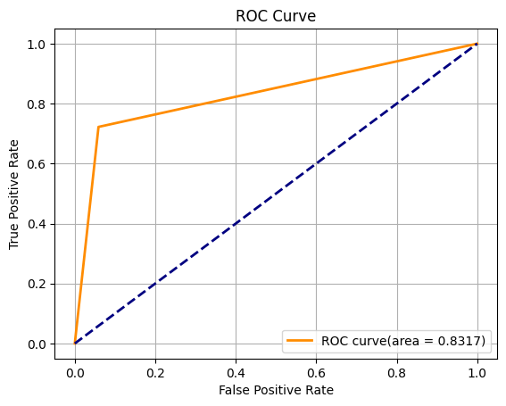
Test Dataset ROC Curve
# Plot the ROC curve.
# Display the plot.

Slide 14
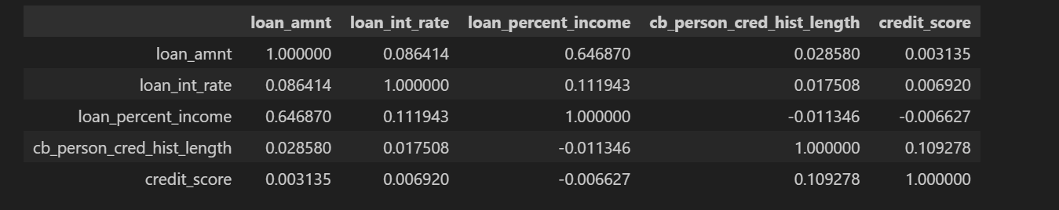
Multicollinearity Asscessment
No, since we don't see any explanatory variables pair that have correlation value greater than the threshold(0.7).

Slide 15
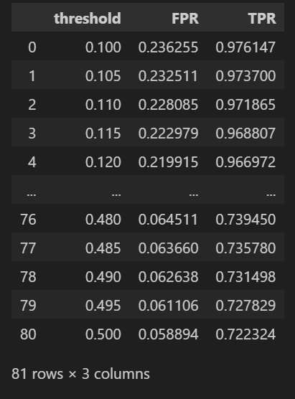
Best Predictive Probability Threshold
The ROC curve’s closest point to the ideal (TPR = 1, FPR = 0) is (TPR = 0.72, FPR = 0.06), corresponding to a threshold of 0.495 —— high recall with acceptably low false alarms. Lowering the threshold would boost TPR but also raise FPR, so the trade-off merits careful consideration.

Slide 16
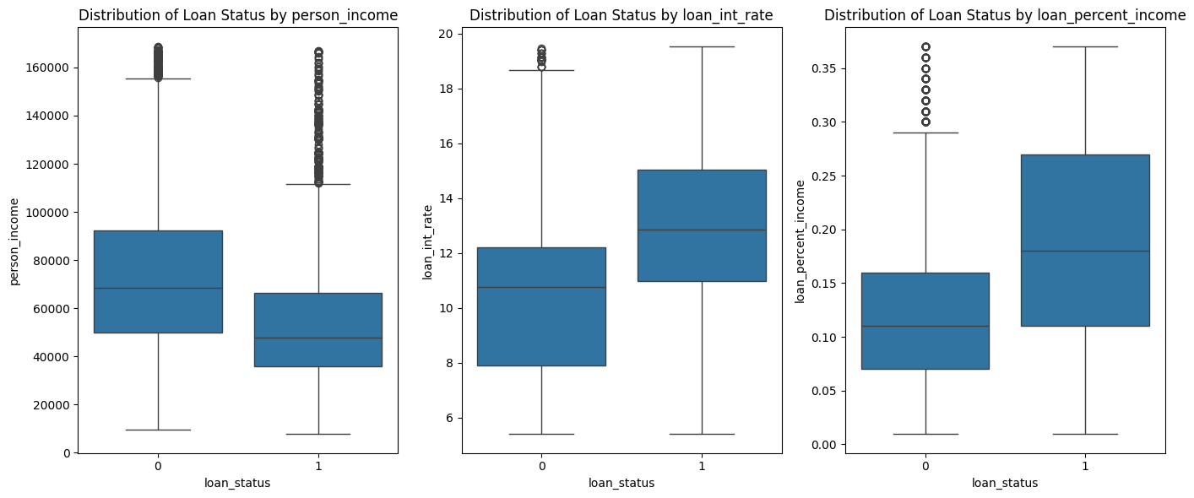
Additional Analysis/Insight
T-tests on person_income, loan_int_rate, and loan_percent_income confirmed significant differences between approved and rejected applicants, as suggested by the boxplots.
Yet not all three appear in the final model—interactions or multicollinearity likely dilute their combined predictive value.

Slide 17
Conclusion
Recommendation
Shortcomings
Future Work

Slide 18
Thank you

